Slide 1





Slide 2

Expect Miracles Foundation (EMF) rallies the financial services industry and beyond to invest in life-saving cancer research while advancing the financial and emotional health of people impacted by cancer.
EMF has awarded over $25M in grants in support of our mission!

Slide 3


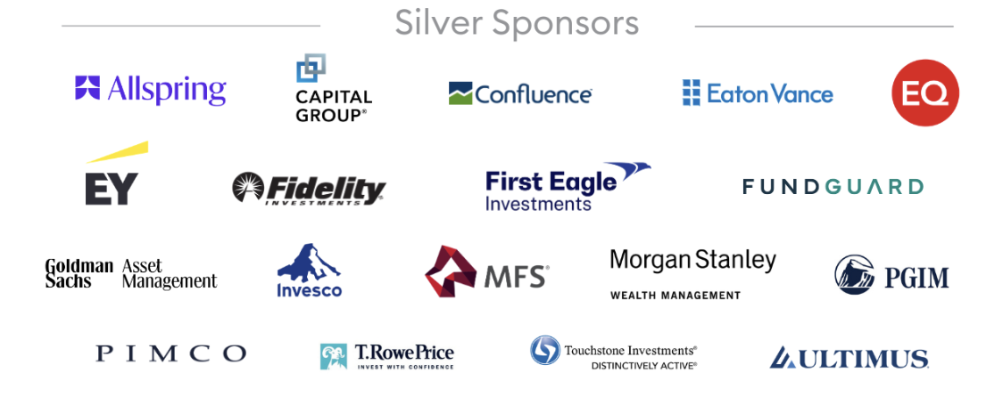
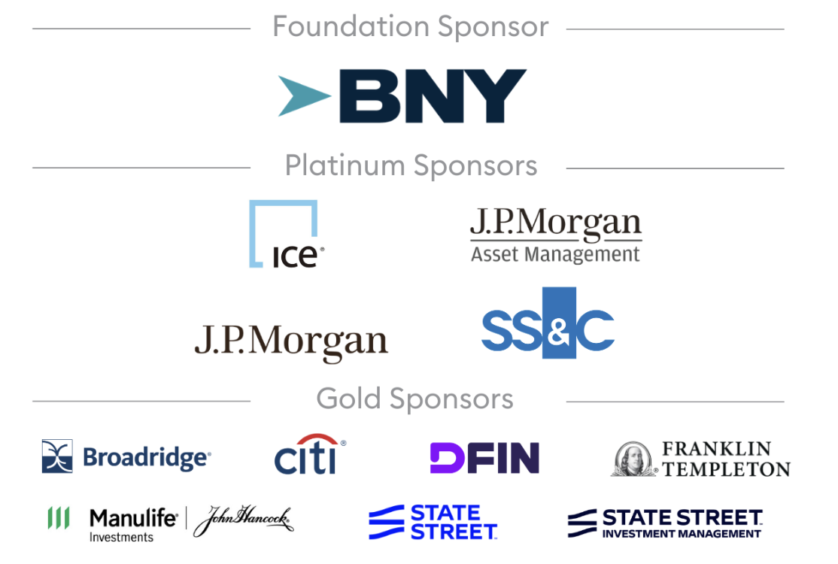
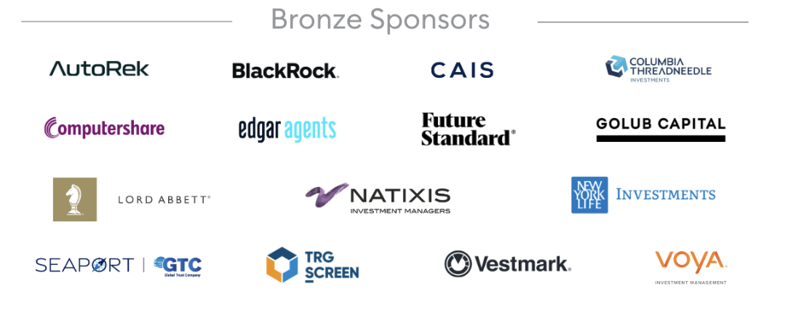

EMF History
EMF is a unique nonprofit that brings together doing good and being seen doing good. Through high-impact events like golf tournaments and galas, we create opportunities for financial firms to support a meaningful cause while also gaining valuable marketing exposure and networking with industry peers. It’s a powerful blend of philanthropy, visibility, and connection—all while making a real difference.
2026 EMF
Corporate Sponsors

Slide 4
What began as a creative solution during the pandemic has become our biggest event. When in-person gatherings paused, EMF launched the Distance Challenge—uniting 2,000 participants across 21 countries last year and raising $1.4 million. It’s a powerful way to take action in the fight against cancer.

Slide 5
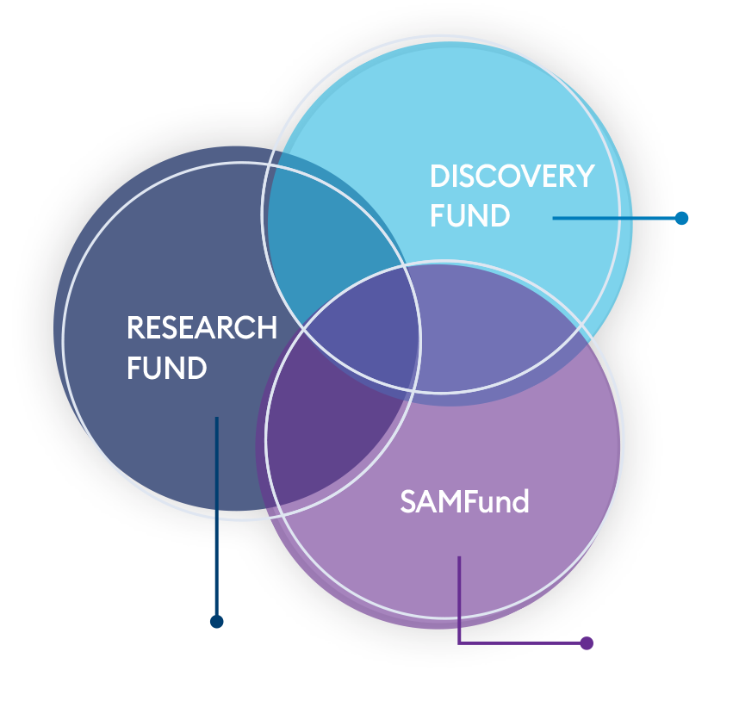
Our Impact
Discovery Fund at Dana-Farber Cancer Institute
Research Fund at Memorial Sloan Kettering Cancer Center
Both of these cancer research funds focus on four major challenges in cancer research:
Early detection
Real-time prognosis
Drug-resistant cancers
Metastatic cancers, responsible for 90% of cancer deaths

Slide 6
Our Impact
While we work to help patients become cancer-free, we know that cancer isn’t free—it’s expensive. That’s where our next fund comes in:
3. The SAMFund
This fund provides financial assistance to young adult cancer survivors (ages 21-39) who face the highest financial burden. We support them with rent, mortgage, car payments, education, and family building—helping them not just survive but move forward.

Slide 7
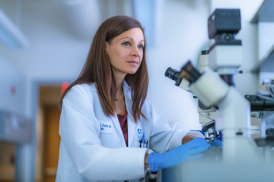

Progress is Happening
Good news: Progress is happening.
Liquid biopsies are detecting cancer earlier.
Faster diagnostics mean less agonizing waiting.
New targeted therapies are giving metastatic patients more time and better quality of life.
More young adults can rebuild their lives after a cancer diagnosis.
Thanks to the generosity of our sponsors, 100% of all participant-raised dollars through the Distance Challenge support EMF's portfolio of funds!

Slide 8
Distance Challenge
The Distance Challenge is our chance—your chance—to take action in the fight against cancer. How far will you go to leave cancer behind?
May 12 - 19, 2026 – Global & Virtual
Global, virtual 8-day event.
Fun reason to connect with friends and colleagues & get active.
Chance to compete with other teams and individuals around the world.
Great opportunity to run, walk, bike, or get moving!
Participants set personal fundraising and distance goals.
Distances will be tracked on our website through linking wearable devices to the EMF Distance Challenge app.

Slide 9
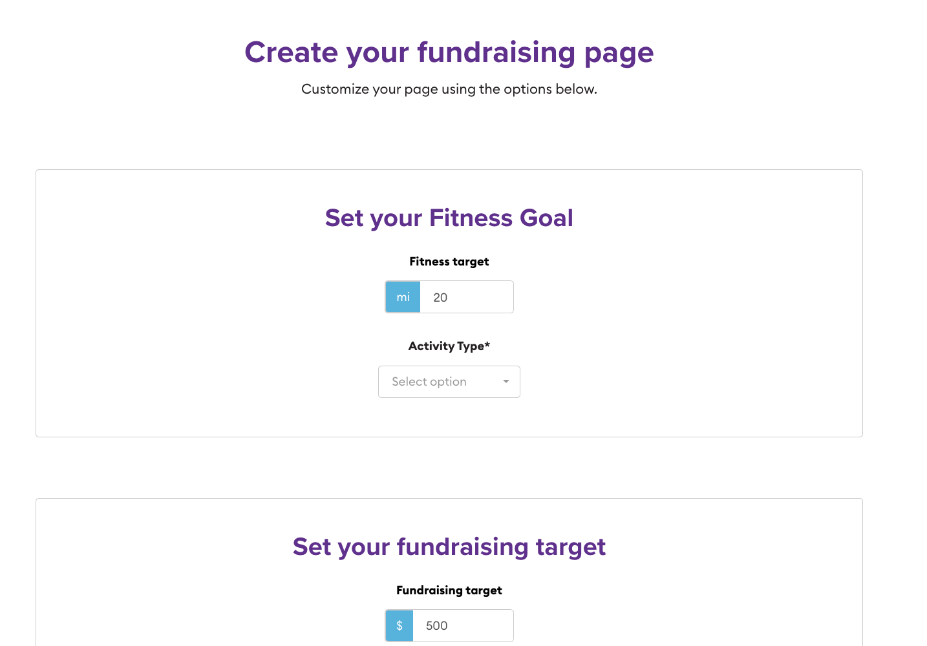
Choose Activity & Distance

Slide 10
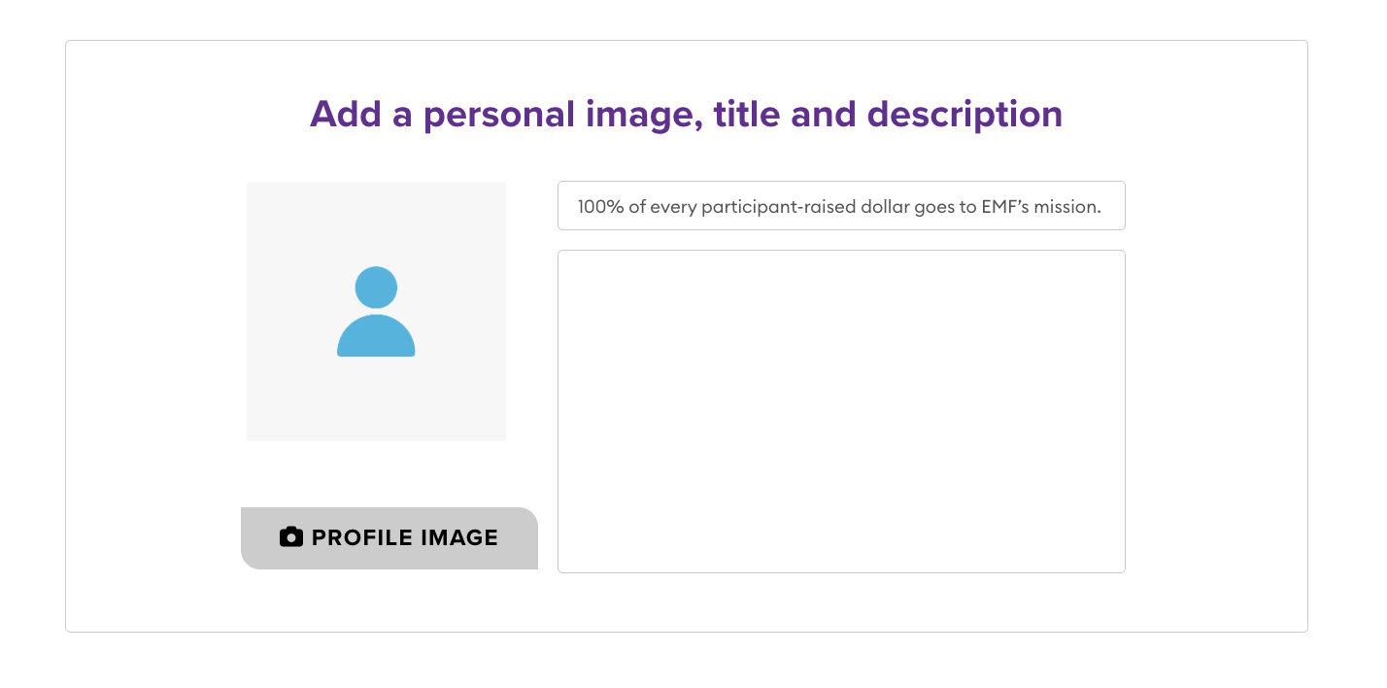
Customize Your Page

Slide 11
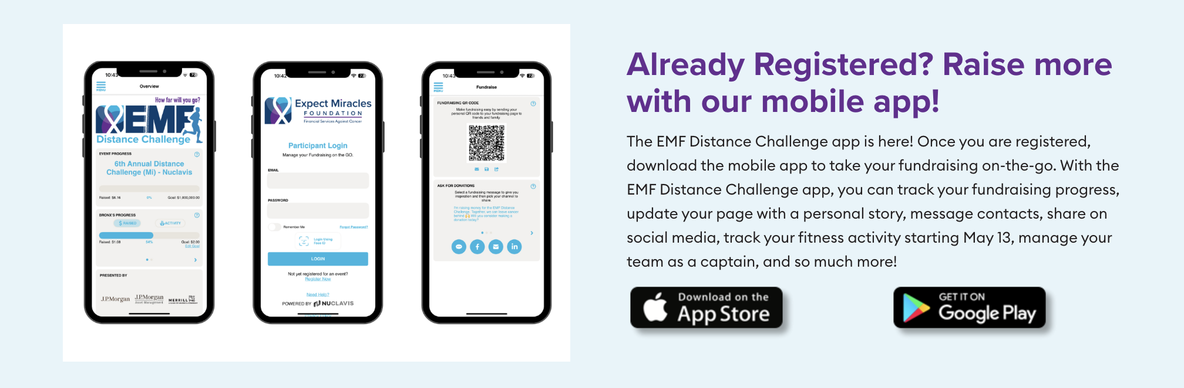
Download App
Visit: https://bit.ly/m/EMFDistanceChallengeApp

Slide 12
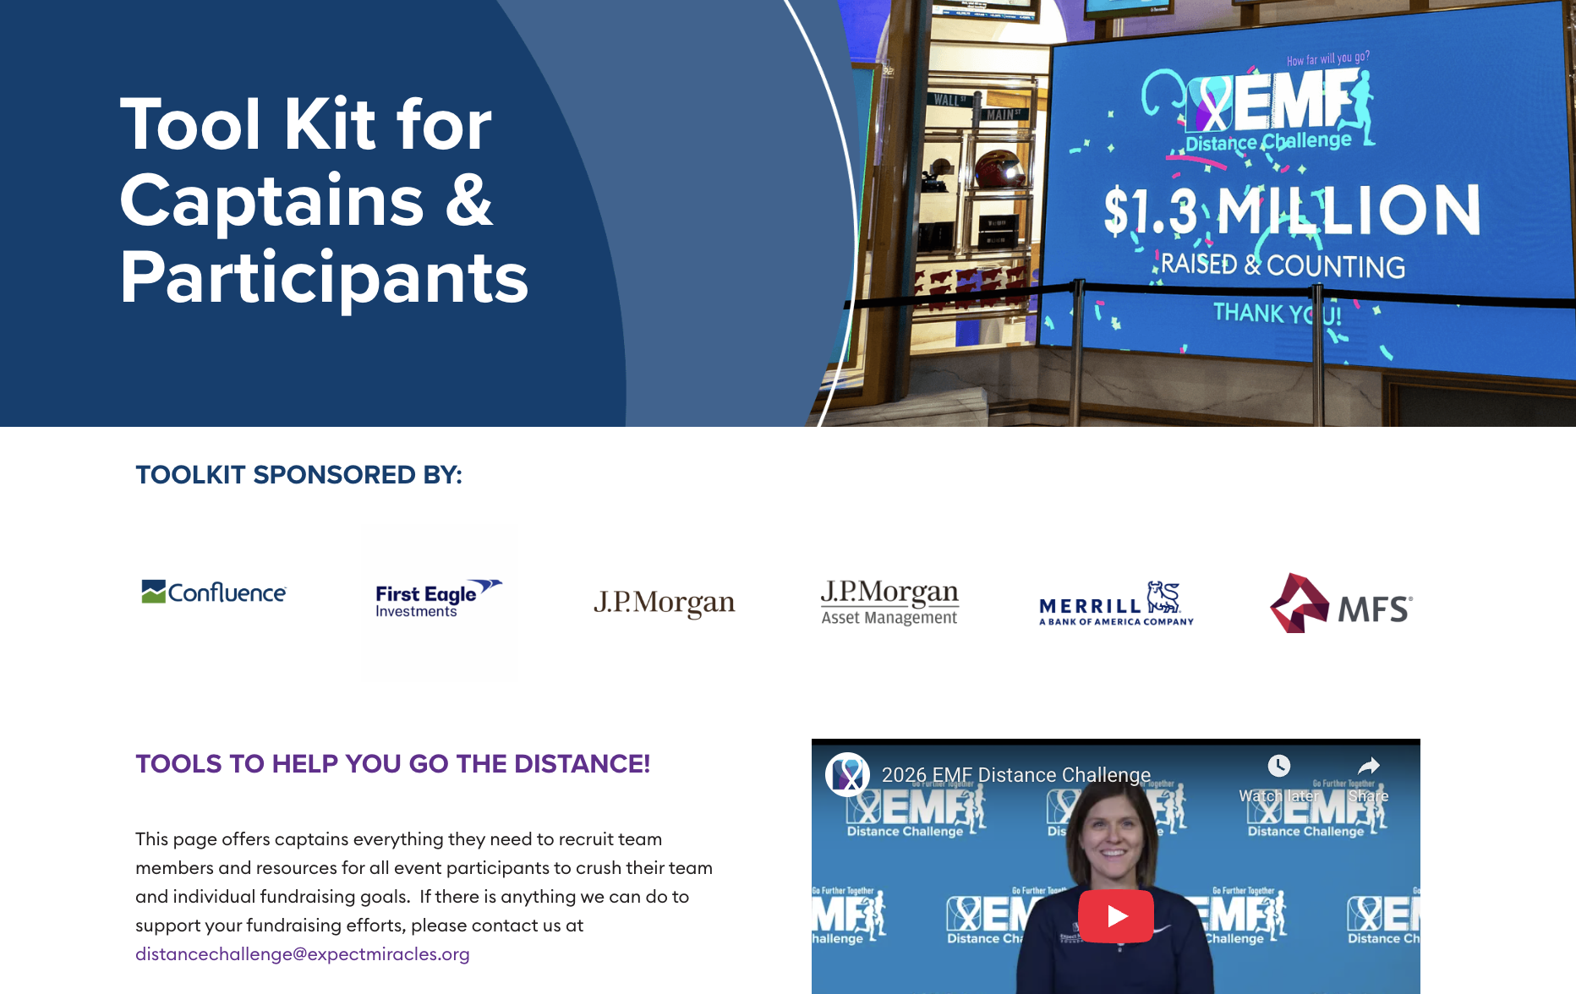
Tool Kit
Visit: https://www.emfdistancechallenge.org/toolkit

Slide 13
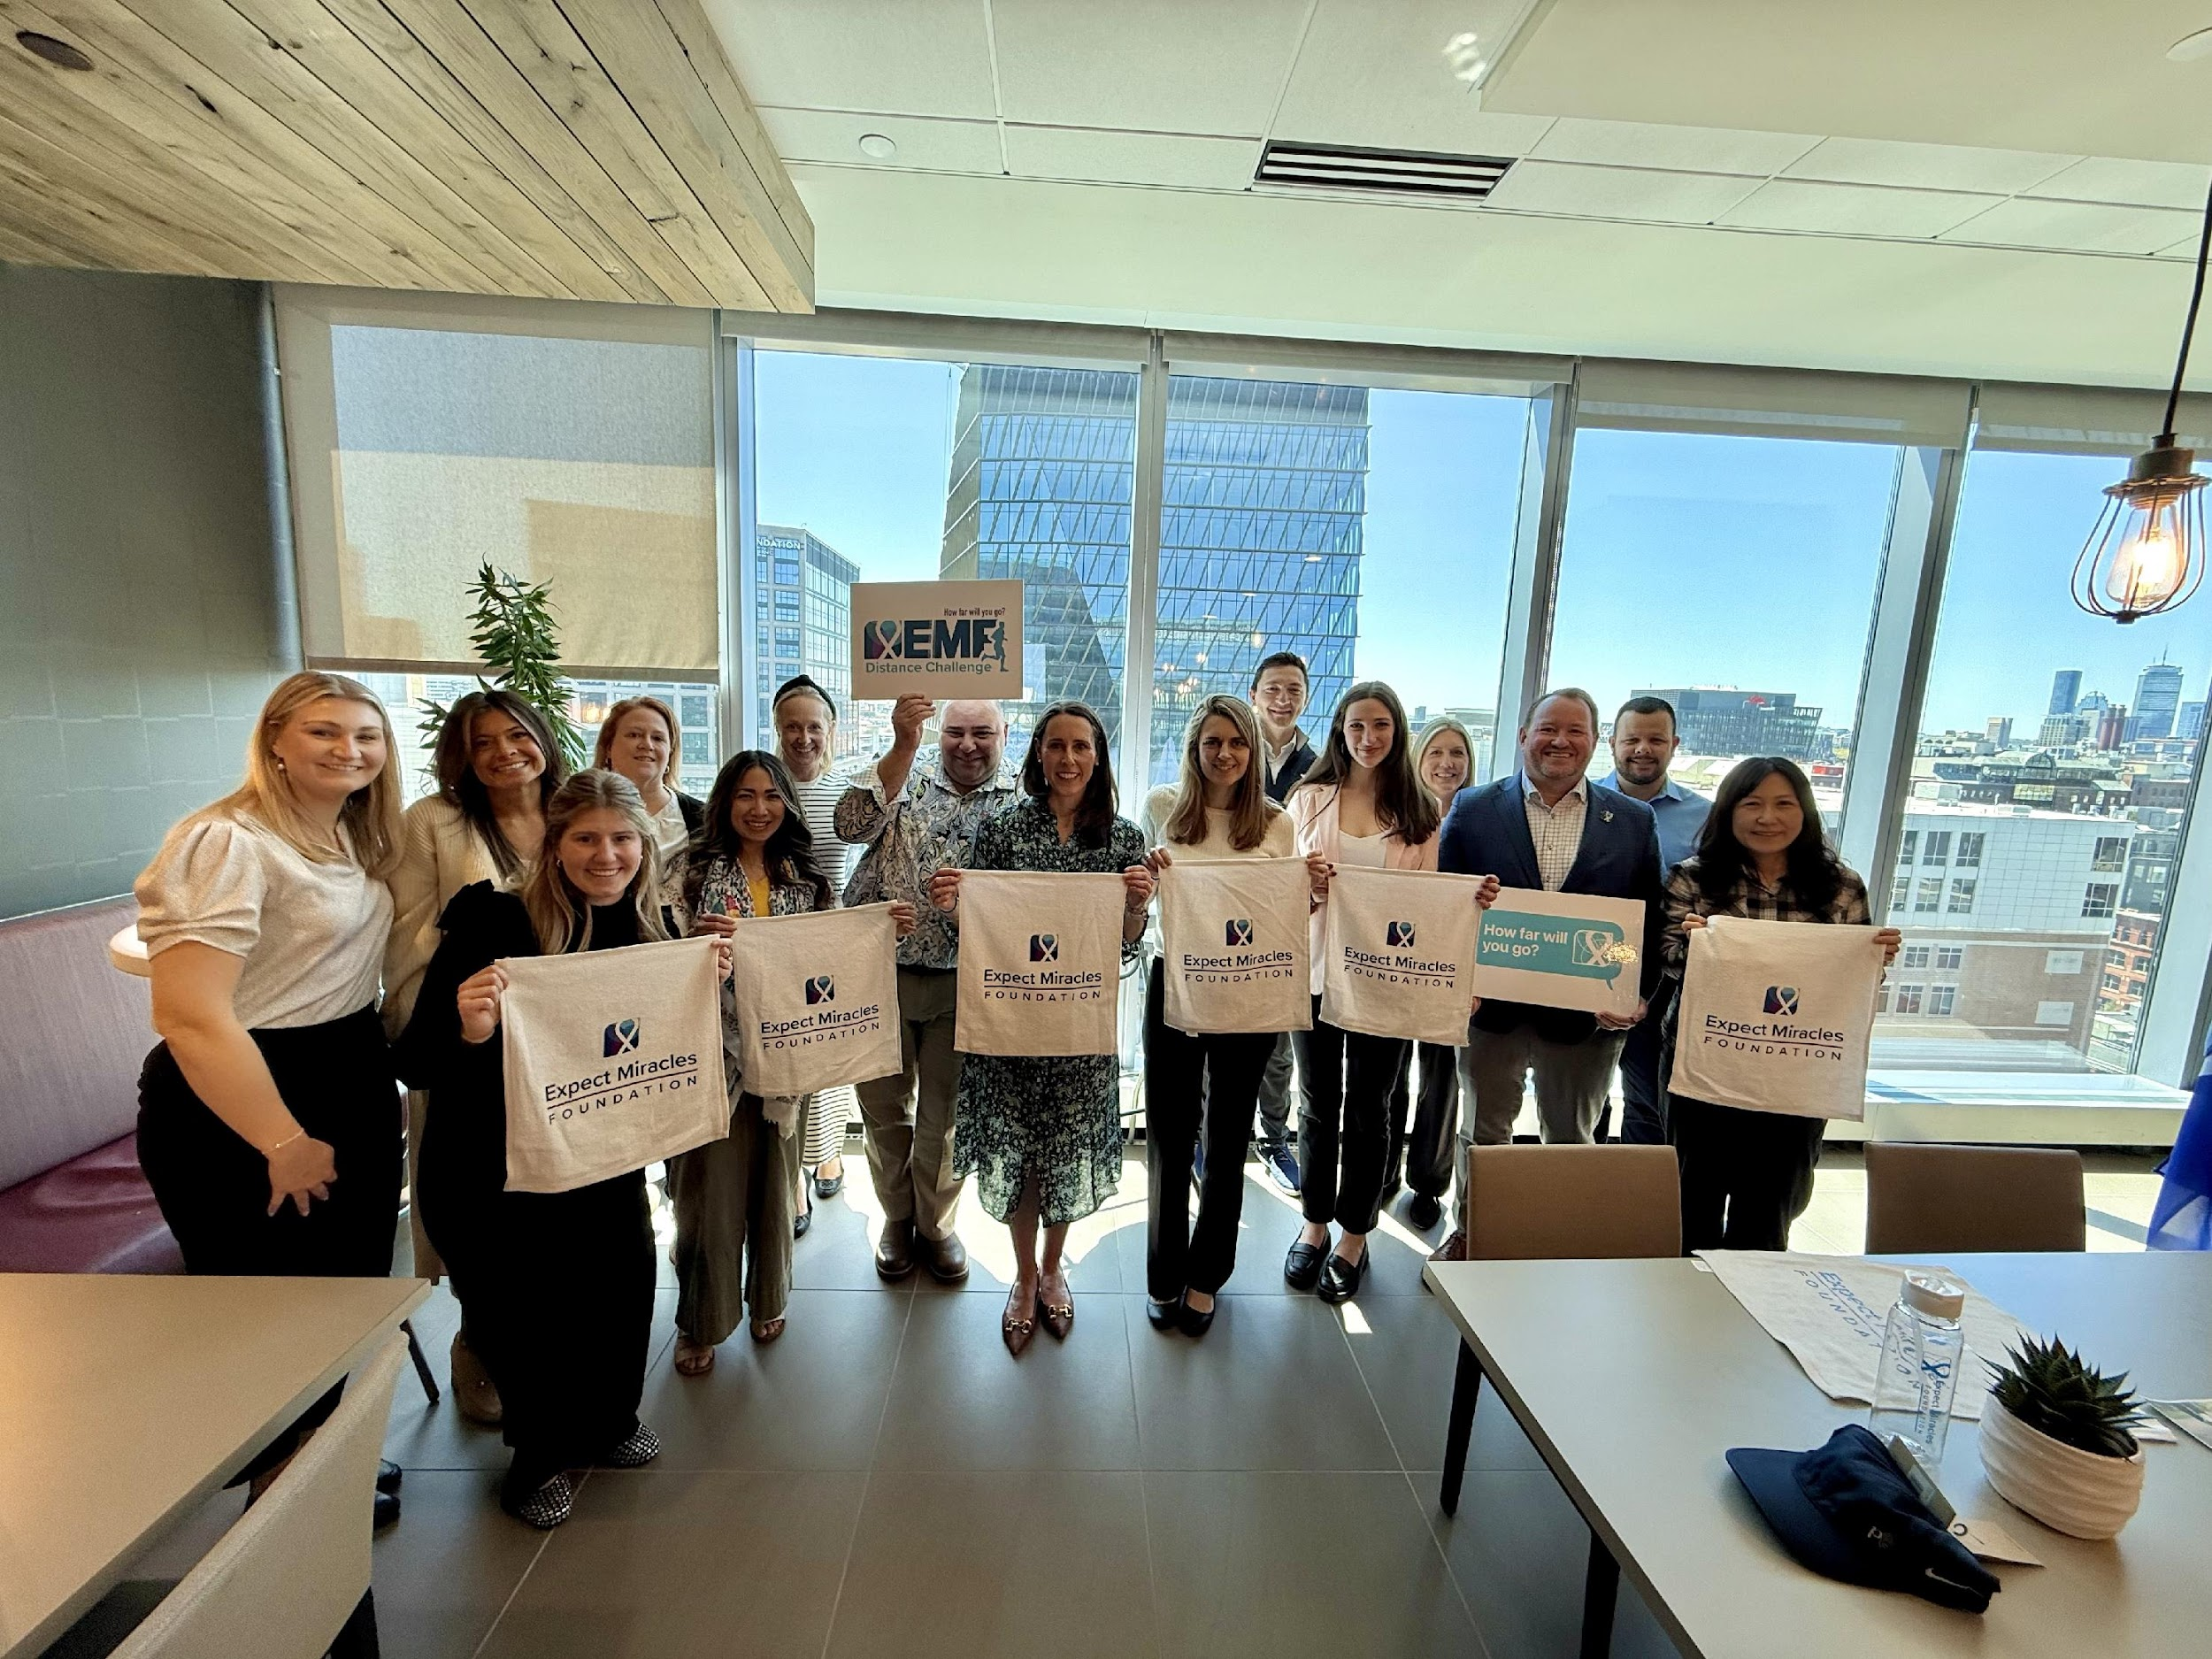
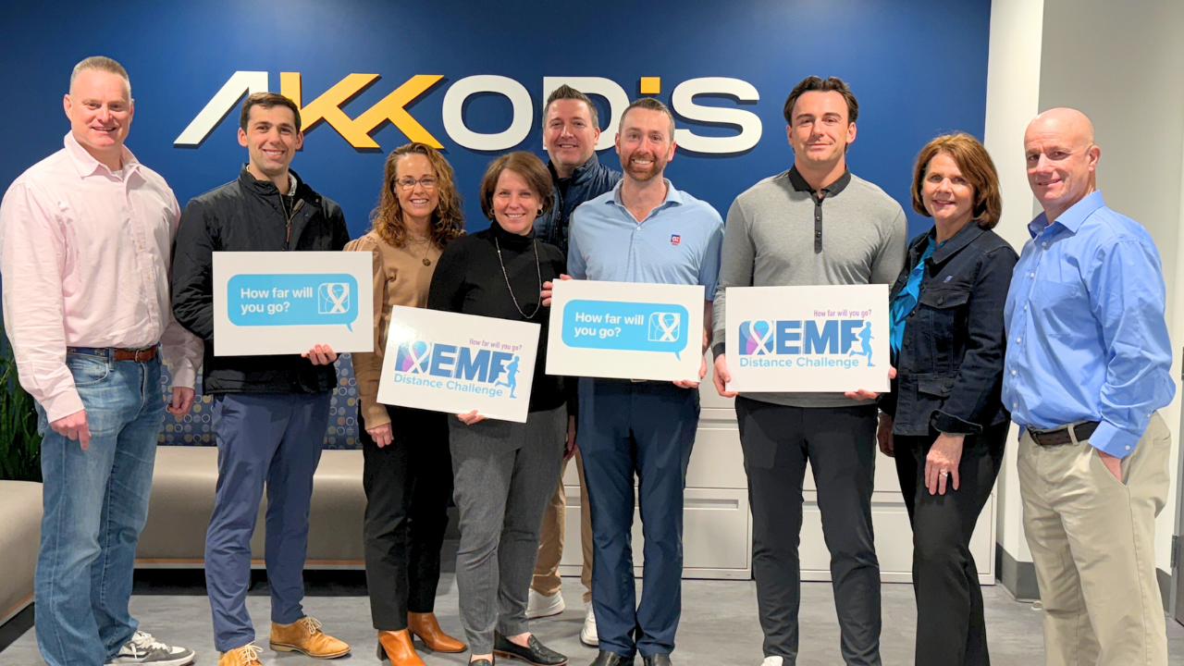
Host a Kick-Off

Slide 14



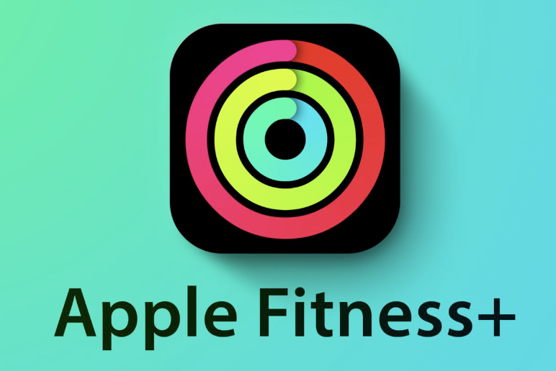
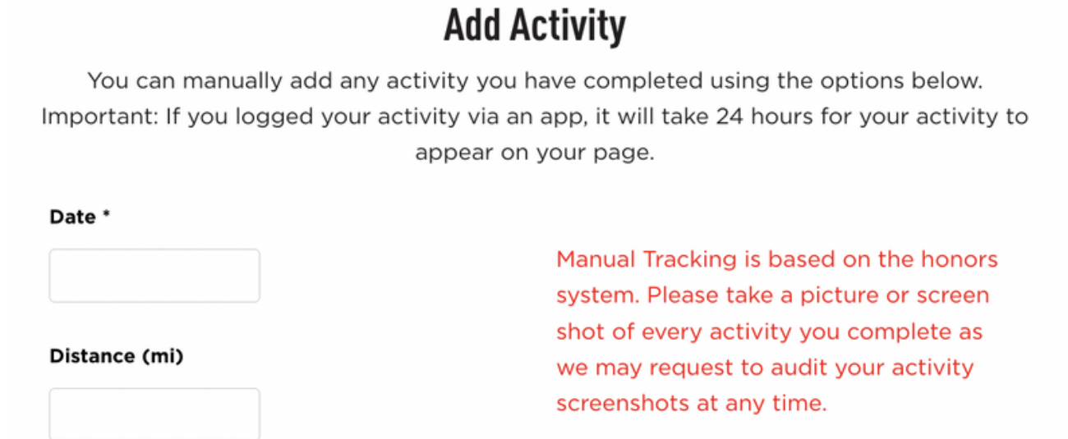
Fitness Tracking

Slide 15
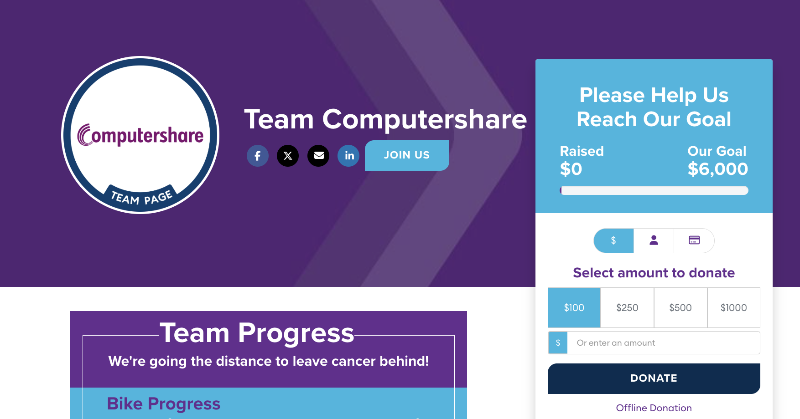
Offline Donations
Visit: https://www.emfdistancechallenge.org/offline-donation
Pledge a Gift via Company Match, Donor Advised Fund, Check (donations not via credit)
Please use this form to record:
A company match for a donation you already made
A donation you would like to make via Donor Advised Fund / Charitable Fund, check, etc.

Slide 16
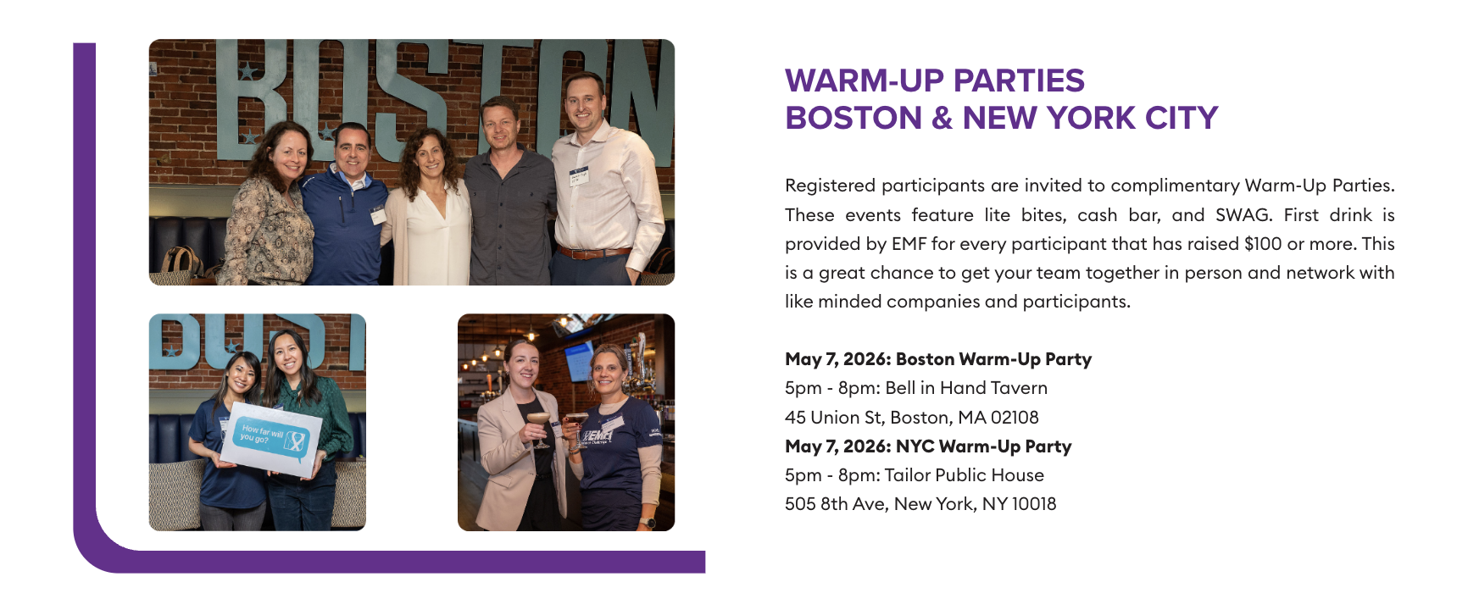
Warm-Up Parties

Slide 17
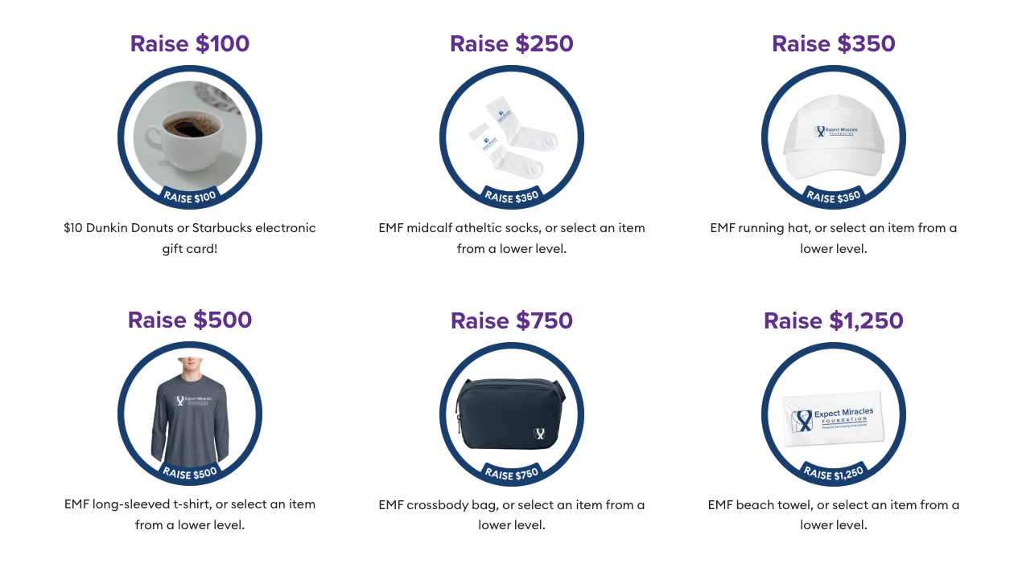
Race Rewards
Visit: https://www.emfdistancechallenge.org/race-rewards

Slide 18
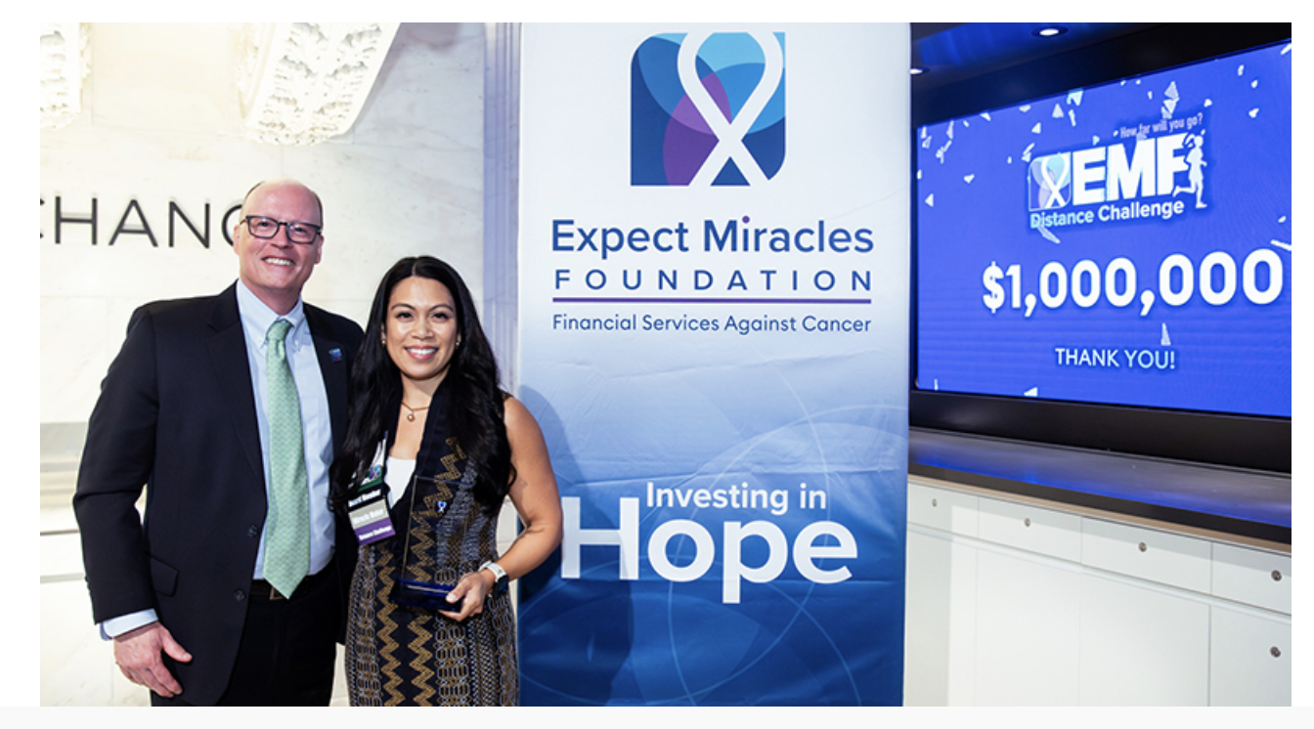
Impact Celebration
Top distance and fundraising winners are invited to
EMF’s Impact Celebration
at the New York Stock Exchange on May 28!

Slide 19

QUESTIONS?

